Slide 1
PUBLICATION DATABASE SYSTEM
BY
RUCHITA JADHAV
SANJEEV RAMASAMY SEENIVASAGAMANI

Slide 2
Content
Project Overview
Project Goals
Entity Relationship Diagrams
Forms
Customer – Subscription
State-wise Customer
Advertisements
Magazine – Issue Tracker
Reports
Advertisement Tracker
Expenditure Tracker
Magazine – Subscription Summary
Expenditure Summary
Subscription revenue

Slide 3
Project overview
Issues:
Data storage & retention
Manual intervention & errors
Effective data processing
Data retrieval
Focus Areas:
Customers
Magazines and their respective issues
Advertisements
Subscriptions
Expenditure for each issue

Slide 4
PROJECT GOALS
Customer details are stored
State-wise advertisement inflow details
State-wise customer details
Expense calculation in publishing the issues
Revenue generated through the subscription
Subscription Rate monitoring

Slide 5
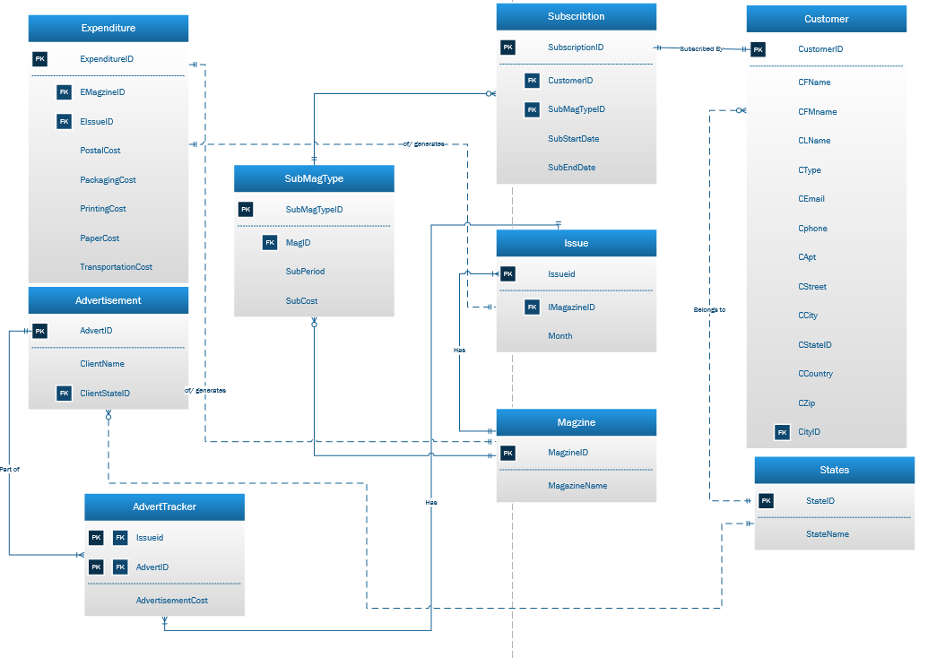
ER Diagram

Slide 6
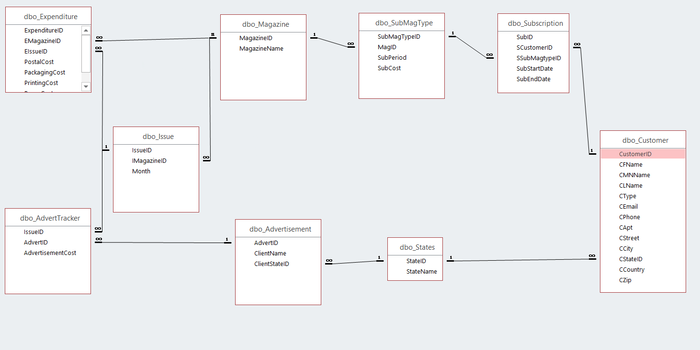
ER DIAGRAM - ACCESS

Slide 7
FORMS
Customer Data Form: Form to view, add, delete, save & print customer data
State-wise Customers: provides a view of the distribution of customers according to the states
Advertisements: displays the state-wise client name and the advertisement id
Magazine Issue Tracker: it’s a form to view, add magazine related information like magazine cost, issue information

Slide 8
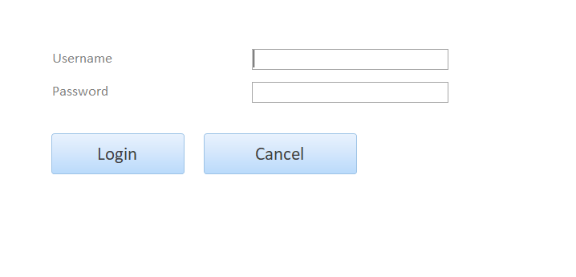
Forms – Log in page

Slide 9
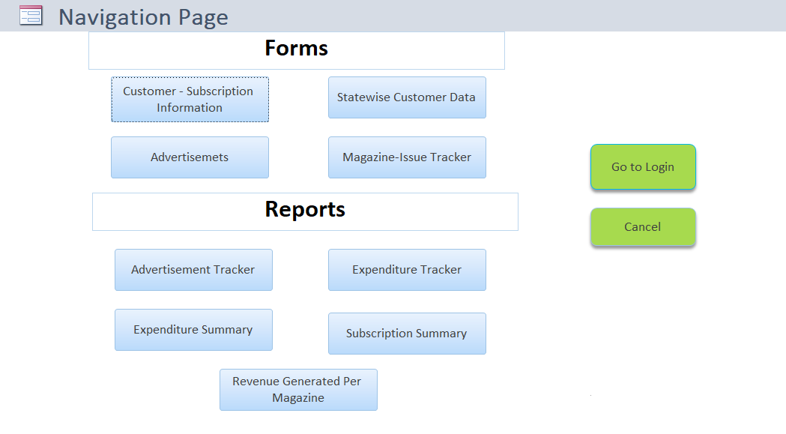
Forms - Home/navigation page

Slide 10
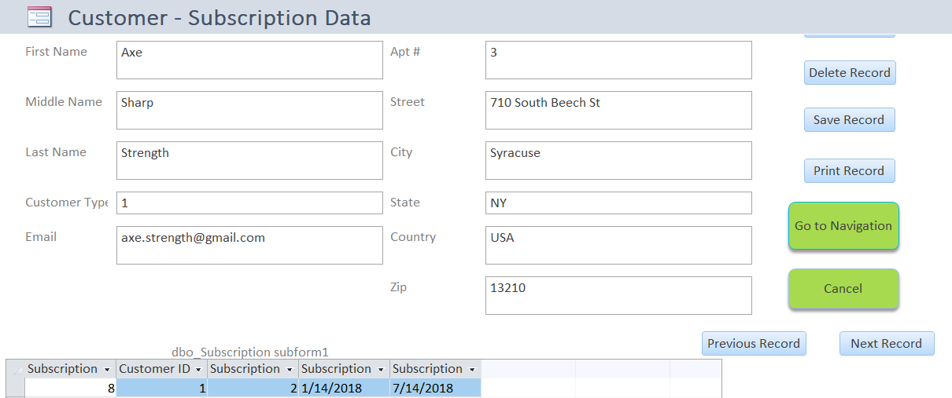
Forms – customer & subscription data

Slide 11
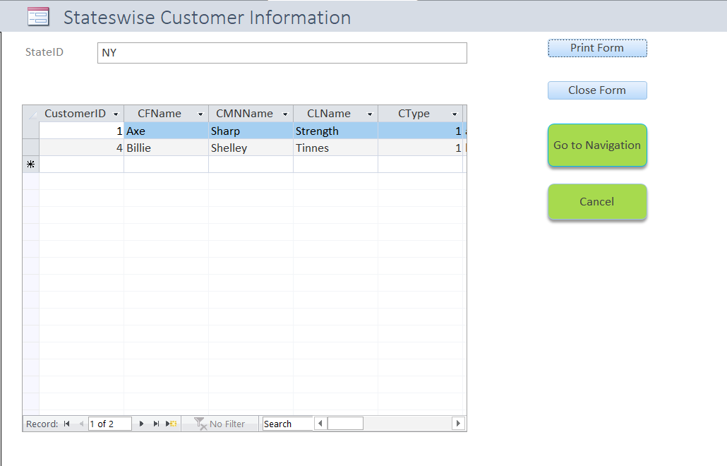
Forms – state-wise customer

Slide 12
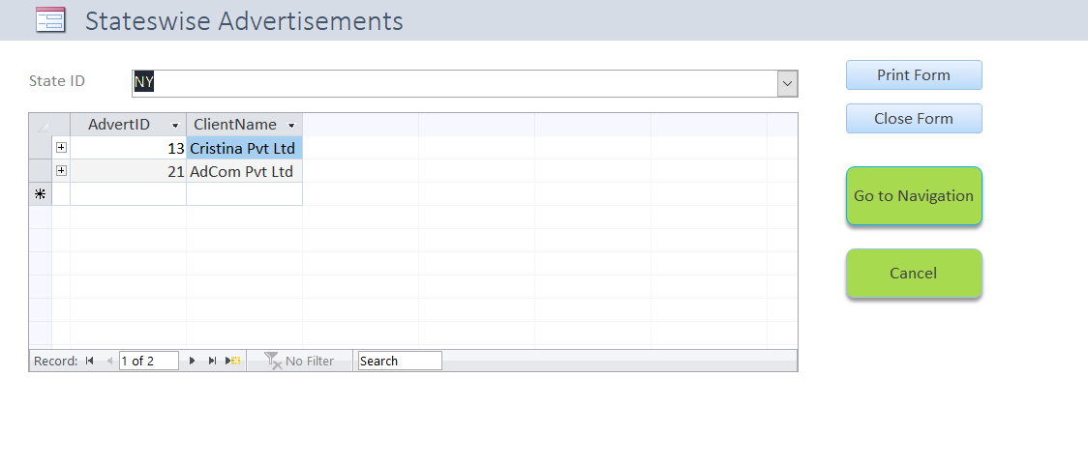
Forms – State-wise advertisements

Slide 13
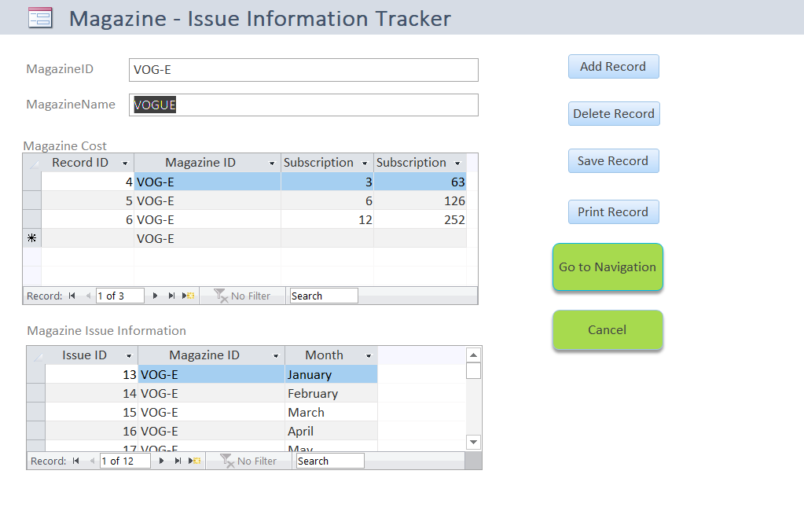
Forms – State-wise magazine-issue tracker

Slide 14
reports
Advertisement Tracker: provide information regarding the advertisements published and the client who provided it
Expenditure Tracker: displays postal cost, packaging cost, paper cost and transportation cost for each issue id provided via parameter
Magazine Subscription Summary: cost of each type of subscription and its duration
Expenditure Summary: reports the expenses incurred while publishing the issues
Subscription Revenue: lists out the revenue from various subscriptions

Slide 15
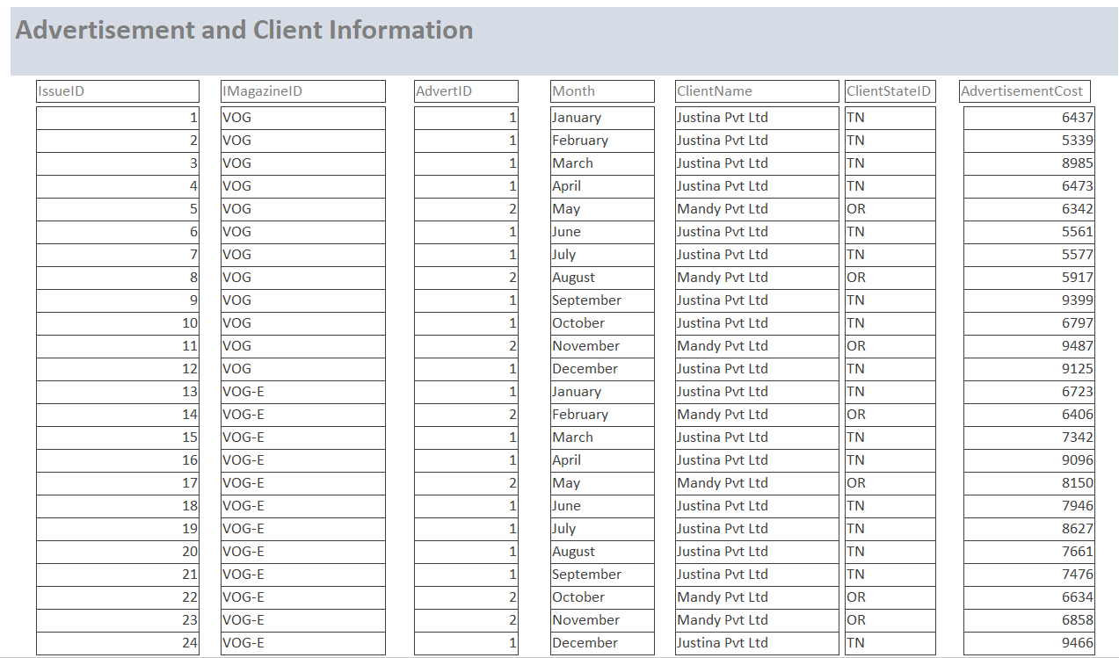
report– advertisement tracker

Slide 16
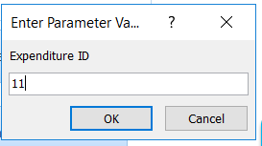
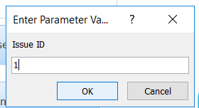
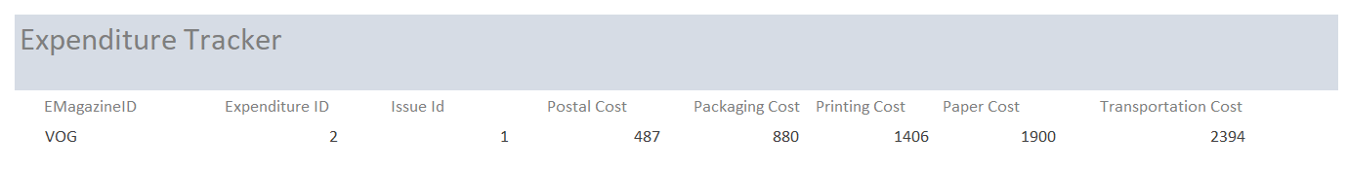
report– expenditure tracker
Enter the parameter values
Output Report:

Slide 17
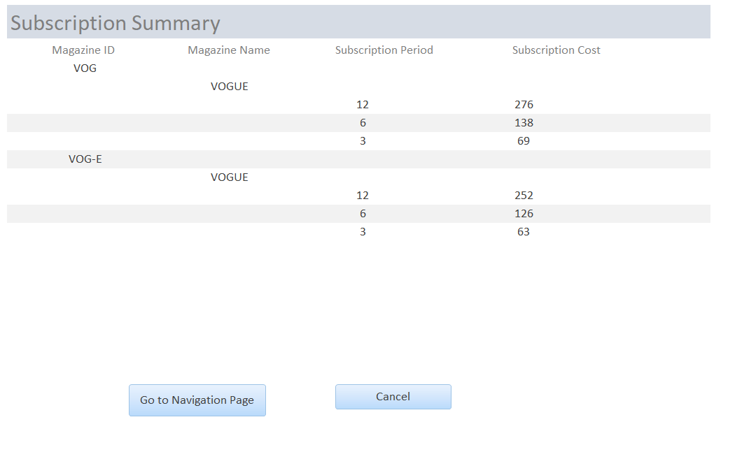
report– magazine subscription summary

Slide 18
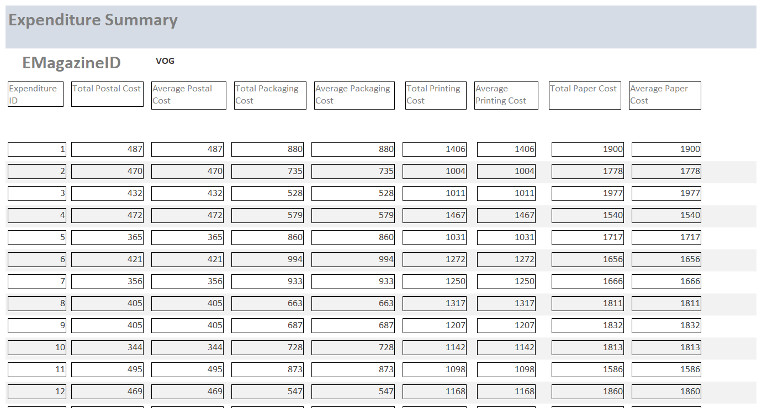
report– expenditure summary

Slide 19
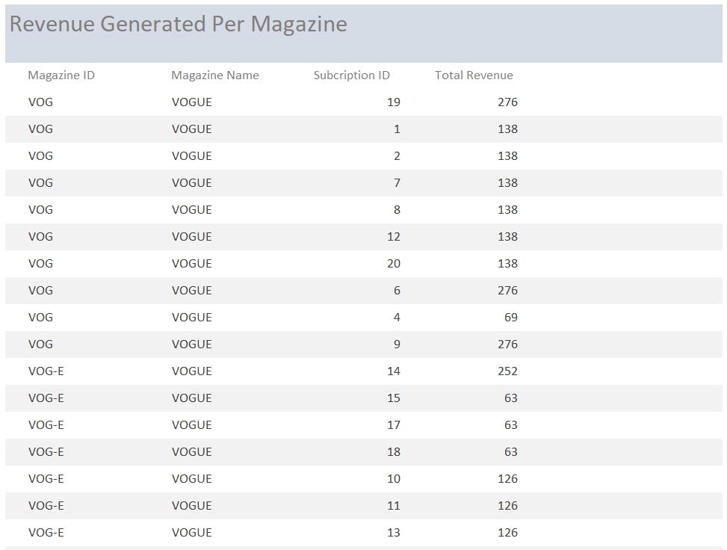
report– revenue generated per magazine

Slide 20
Major data questions
What is the Total Revenue for the month of July 2018?
What is the total Number of new Subscriptions for the Vogue Magazine March 2018's E-Book issue?
What is the total Number of Advertisements from Tennessee?
What is the Total Number of Customers from the State of New York?
What is the Total expenditure of the January 2018 magazine?

Slide 21
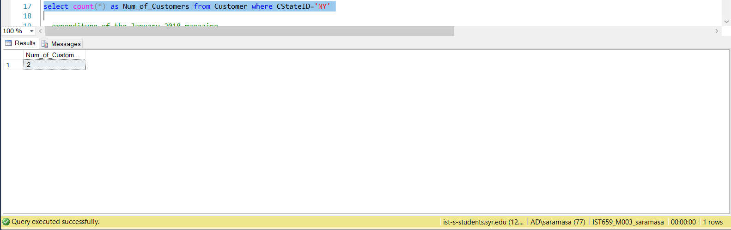
Total Number of Customers from the State of New York?

Slide 22
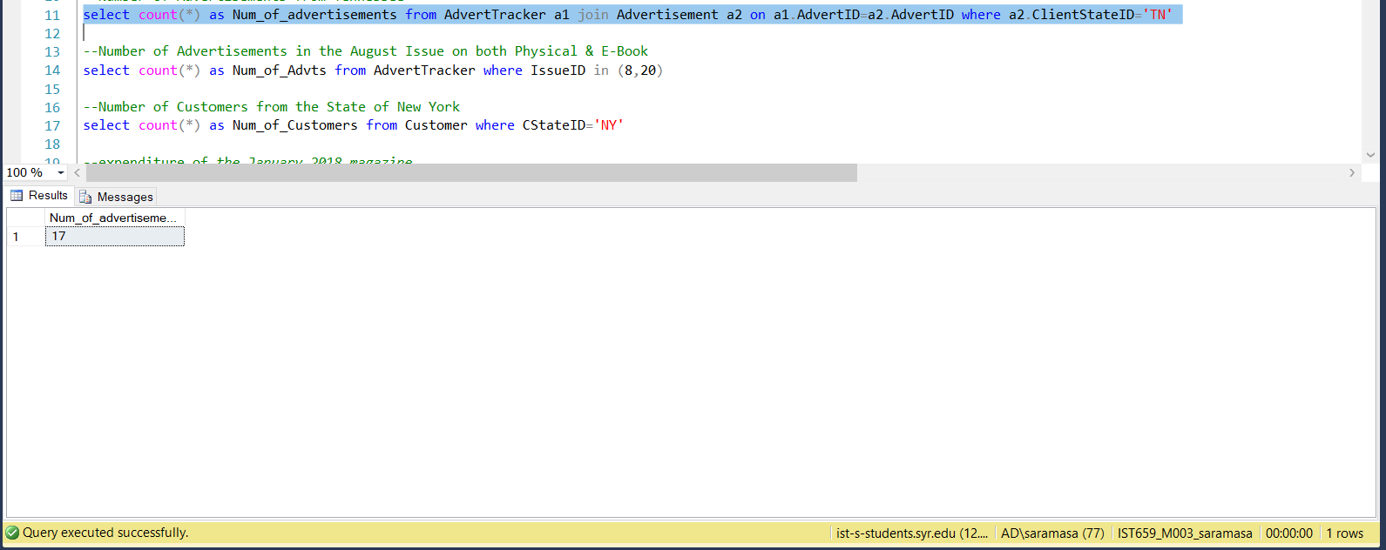
total Number of Advertisements from Tennessee

Slide 23
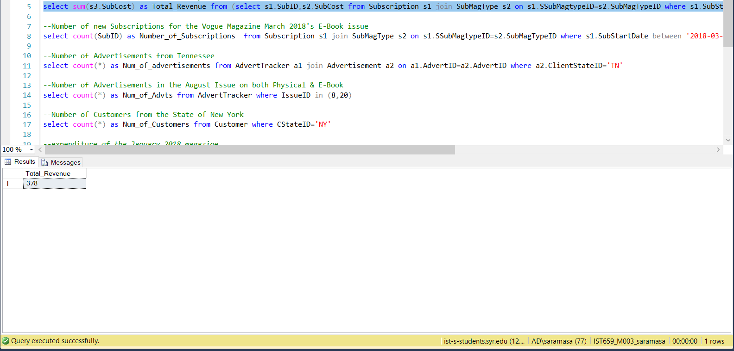
Total Revenue for the month of July 2018

Slide 24
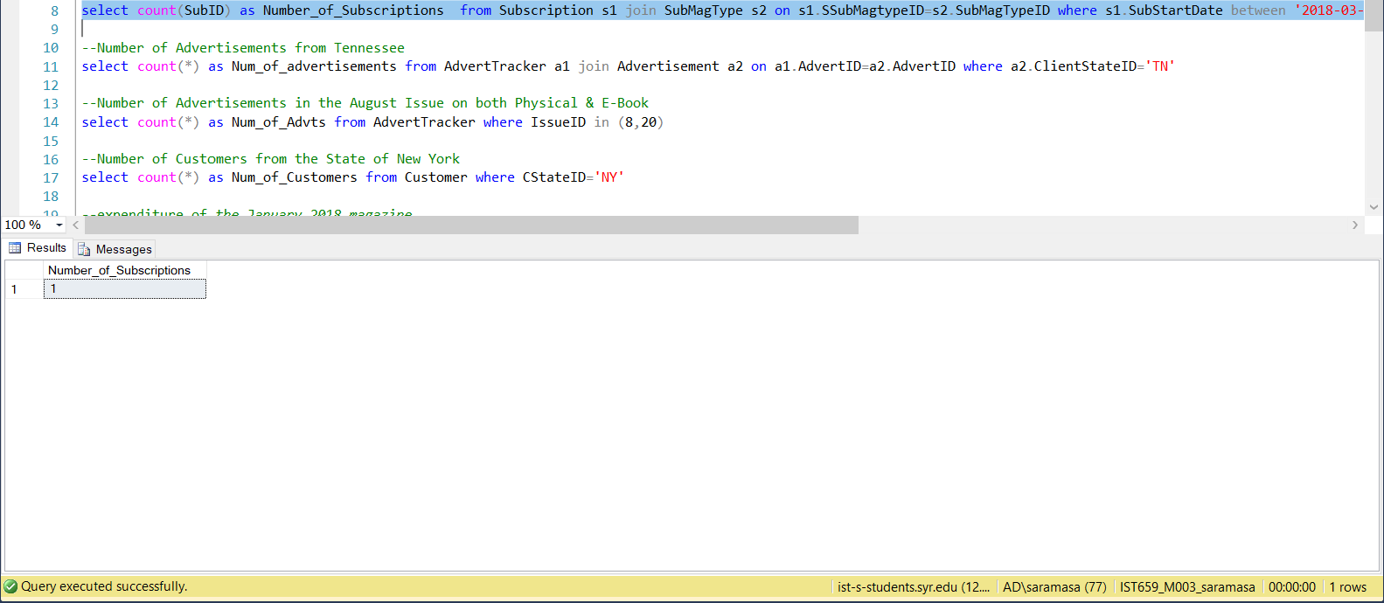
total Number of new Subscriptions for the Vogue Magazine March 2018's E-Book

Slide 25
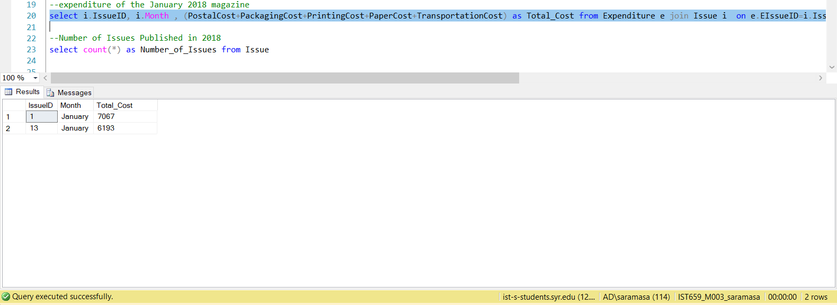
Total expenditure of the January 2018 issue

Slide 26
Thank you.

